Slide 1
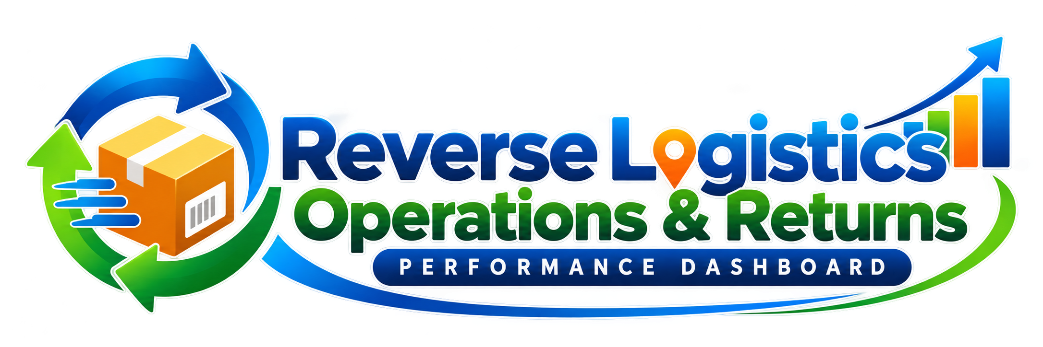
Project Presentation
Supply Chain Operations Associate • Reverse Logistics
Excel-based operational analysis • KPI monitoring • SLA & returns performance

Slide 2
1. Project Objective
Project overview
Business context
Business relevance
• Analyze customer returns and reverse-logistics transactions.
• Track processing performance, refunds and SLA adherence.
• Identify patterns by warehouse, carrier, return reason and product.
• Convert transaction-level Excel data into clear management KPIs.
Data handled
SLA tracking
500 records
58.6%
Processing
Refund value
6.98 days
₹2.9 M
Focus: transactional supply-chain execution, exception identification and operational reporting.

Slide 3
2. Data & Process Flow
Excel analysis
Dataset scope
Key fields used
Transactions
Return quantity
Return value
• Order & return dates
• Warehouse and region
• Carrier and sales channel
• Return reason and status
• Inspection & disposition
• Refund status and amount
• Processing days and SLA status
500
1,500
₹14.1 M
Operational workflow
1
Return received
2
Inspection
3
Disposition
4
Refund / inventory update
5
SLA monitoring

Slide 4
3. Executive KPI Dashboard
Current project results
Total Returns
Return Quantity
Return Value
Pending Returns
500
1,500
₹14.1 M
125
Completed Returns
Refunded Amount
Avg Processing Days
SLA Compliance
125
₹2.9 M
6.98
58.6%
Management message: returns volume is high, processing averages nearly 7 days, and SLA compliance is the main improvement opportunity.

Slide 5
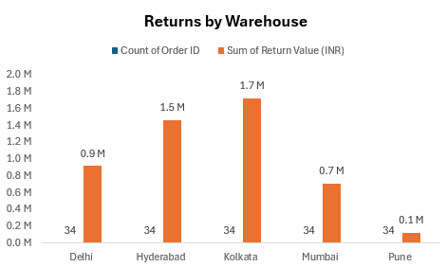
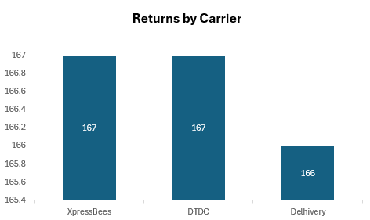
4. Operational Performance Analysis
Warehouse & carrier
Kolkata has the highest return value at ₹1.7M. However, each warehouse shows exactly 34 returns, so the transaction counts may look unrealistically equal.
The values are 167, 167, and 166. The vertical axis starts at 165.4, which exaggerates the small differences.

Slide 6
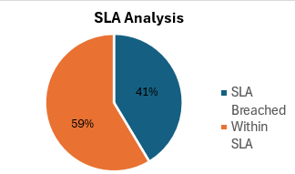
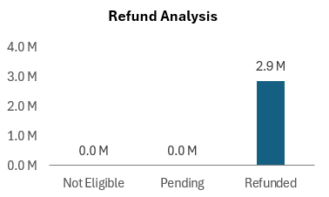
5. SLA & Refund Analysis
Exceptions and financial impact
Within SLA
SLA Breached
293
SLA Compliance
Refunded Value
207
58.6%
₹2.9 M
41.4% of returns breached SLA. Focus on reducing delays and completing return processing within the target time.
₹2.9 million in refunds were processed. Monitor refund accuracy and ensure eligible customers receive refunds on time.

Slide 7
6. Key Insights & Recommendations
What I would do operationally
Key observations
Recommended actions
• 500 return transactions create a meaningful processing workload.
• Average processing time is 6.98 days.
• SLA compliance is 58.6%; 207 transactions are outside SLA.
• Refunded value totals ₹2.9M.
• Customer Changed Mind is the most frequent return reason.
• Prioritize SLA-breached orders using an exception queue.
• Track aging returns daily and escalate items approaching SLA limits.
• Review warehouse workload and rebalance where practical.
• Use return-reason trends to target product, packaging or process issues.
• Validate refund status before operational closure.
• Standardize daily Excel/ERP operational reporting.

Slide 8
7. Project Takeaway
Demonstrated capabilities
From raw transactions to an actionable supply-chain dashboard
Data Handling
Operational KPIs
SLA Monitoring
Business Action
Clean, filter and summarize transactional records.
Track volume, value, pending, refunds and cycle time.
Identify breaches and quantify compliance.
Translate findings into practical process improvements.
Thank you
This project demonstrates my ability to analyze operational data, monitor SLA performance, and identify opportunities to improve reverse-logistics processes.
Excel • Supply Chain Operations • Reverse Logistics • SLA Performance

